Slide 1
Regression Fundamentals I
UIUC ECON 490: Applied Machine Learning in Economics

Slide 2
Inference Interpretation
Height vs. Weight

Slide 3
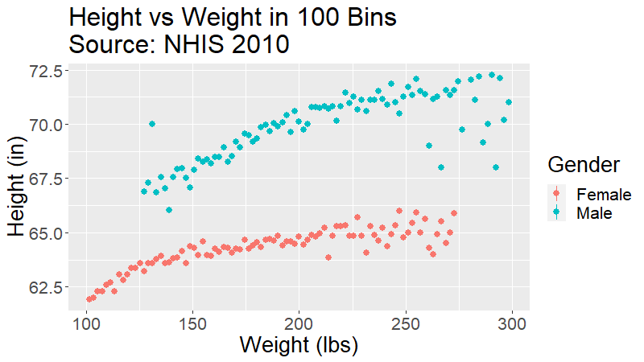
Make Me Taller

Slide 4
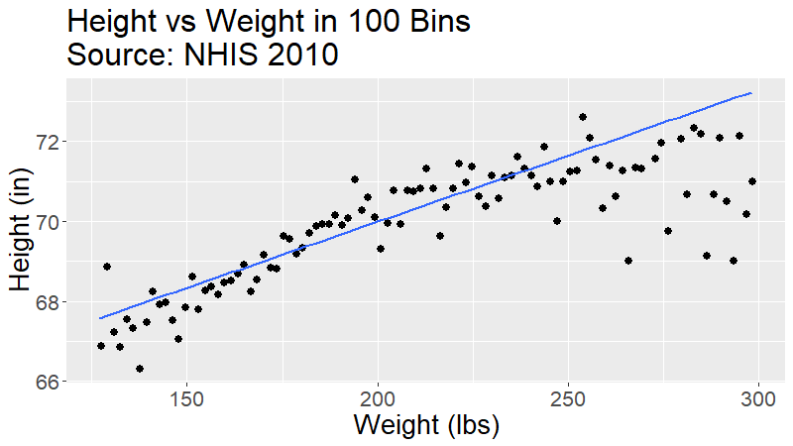
Make Me Taller

Slide 5
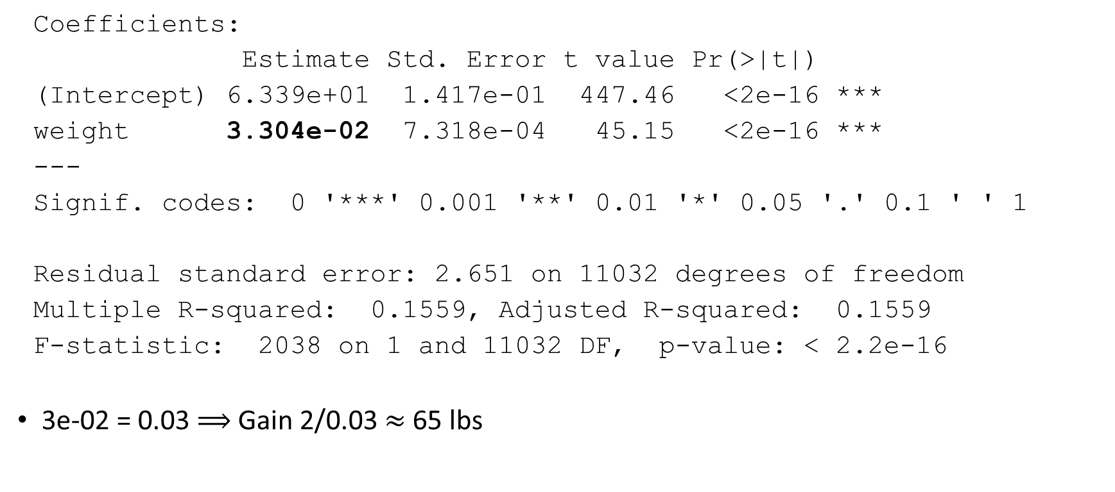
Make Me Taller
Coefficients: Estimate Std. Error t value Pr(>|t|) (Intercept) 6.339e+01 1.417e-01 447.46 <2e-16 *** weight 3.304e-02 7.318e-04 45.15 <2e-16 *** --- Signif. codes: 0 '***' 0.001 '**' 0.01 '*' 0.05 '.' 0.1 ' ' 1 Residual standard error: 2.651 on 11032 degrees of freedom Multiple R-squared: 0.1559, Adjusted R-squared: 0.1559 F-statistic: 2038 on 1 and 11032 DF, p-value: < 2.2e-16
3e-02 = 0.03 $⟹$ Gain 2/0.03 $≈$ 65 lbs

Slide 6
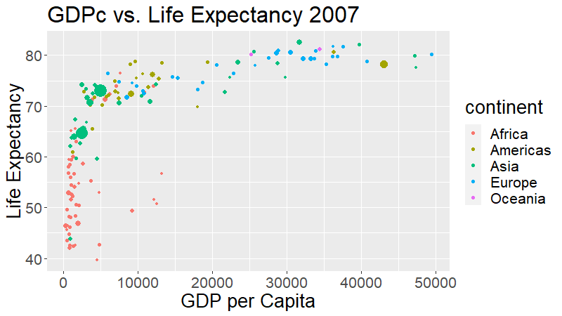
Careful…

Slide 7
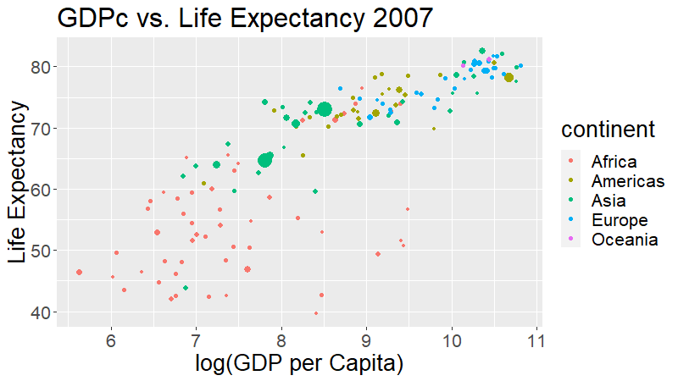
Careful…

Slide 8
Careful…
lm(formula = log(gdpPercap) ~ lifeExp, data = gm) Coefficients: Estimate Std. Error t value Pr(>|t|) (Intercept) 2.52747 0.37988 6.653 5.97e-10 *** lifeExp 0.09086 0.00558 16.283 < 2e-16 *** --- Signif. codes: 0 '***' 0.001 '**' 0.01 '*' 0.05 '.' 0.1 ' ' 1 Residual standard error: 0.7999 on 140 degrees of freedom Multiple R-squared: 0.6544, Adjusted R-squared: 0.652 F-statistic: 265.2 on 1 and 140 DF, p-value: < 2.2e-16

Slide 9
Careful…

Slide 10
Estimation
Ordinary Least Squares

Slide 11

Theory vs. Practice
Assume data generating process (DGP)
$$Y=f\left(X\right)+ε$$
$$ε ∼N(0,σ^{2})$$
$$f\left(X\right)=α+X_{1}β_{1}+…+X_{p}β_{p}$$
In practice
$$y=\hat{α}+x_{1}\hat{β_{1}}+…+x_{p}\hat{β_{p}}+e$$

Slide 12
Regression Fitting Intuition
Source: https://en.wikipedia.org/wiki/File:Least_Squares.gif

Slide 13
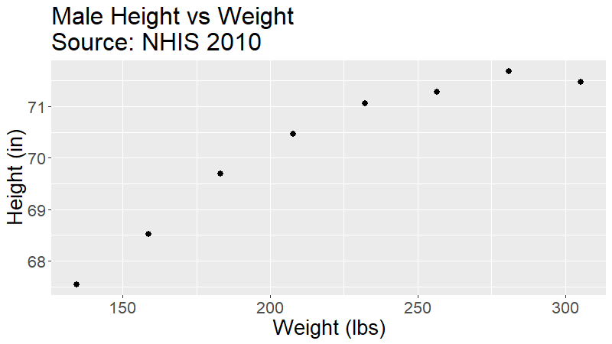
Regression Fitting: Height vs. Weight

Slide 14
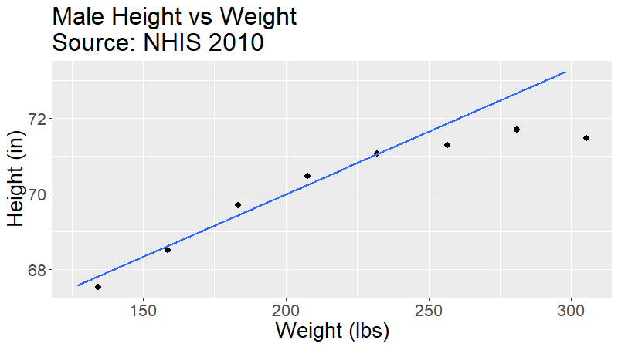
Regression Fitting: Height vs. Weight

Slide 15

BLUE - Best Linear Unbiased Estimator
Gauss-Markov Theorem
Assumptions
Linear in predictors
Random sample
Zero conditional mean of error
$\text{E}[ε|X]=0$
No perfect collinearity of covariates
Homoskedasticity
$\text{V}[ε]=σ^{2}$
No serial correlation
$Cov(ε_{i},ε_{j})=0$ $∀i≠j$

Slide 16
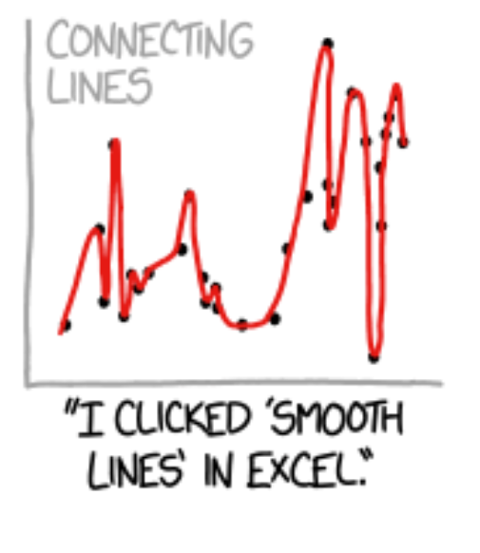
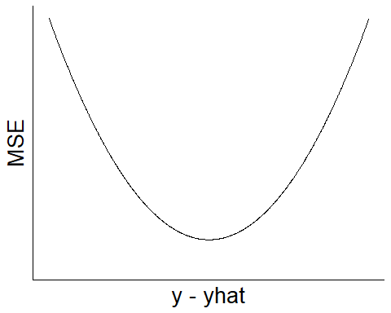
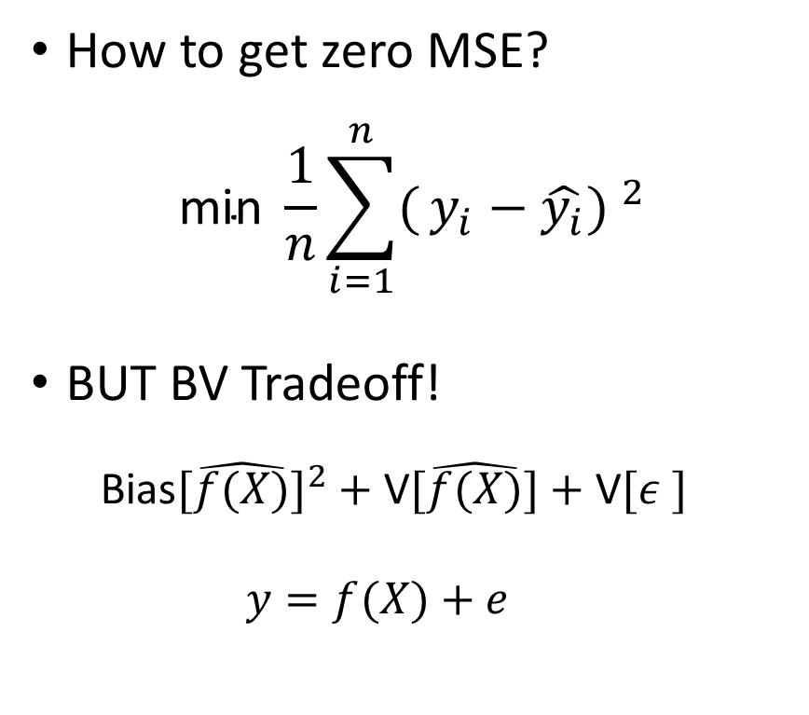
MSE Minimization
How to get zero MSE?
$$\text{min} \frac{1}{n}\sum_{i=1}^{n}{(}y_{i}−\hat{y_{i}}) ^{2}$$
BUT BV Tradeoff!
$$\text{Bias}[\hat{f(X)}]^{2}+\text{V}[\hat{f(X)}]+\text{V}[ε_{ }^{ }]$$
$$y=f(X)+e$$

Slide 17
Bias-Variance Tradeoff
Interpretation vs Flexibility
Linearity assumption

Slide 18

Coefficient Estimation: SLR
$$y=α+x_{1}β_{ }+e$$
$$\hat{α},\hat{β}=\text{argmin} \frac{1}{n}\sum_{i=1}^{n}{[}y_{i}−(α+x_{1}β_{ })]^{2}$$

Slide 19
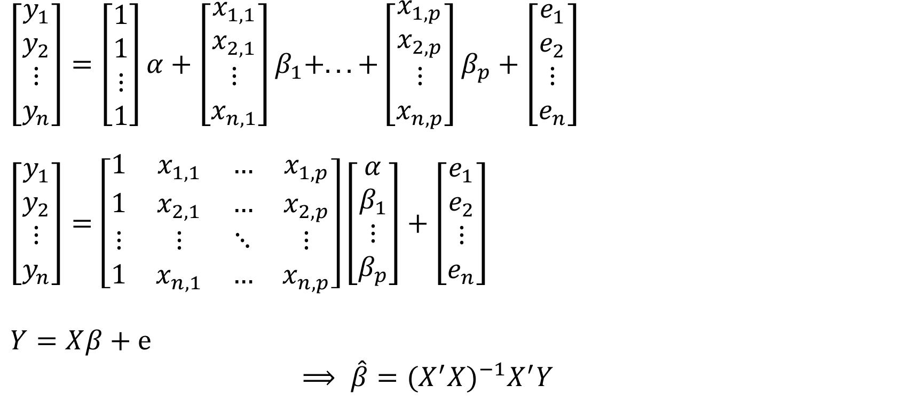
Coefficient Estimation: Multivariate Matrix Notation
$$\left[\begin{matrix}y_{1} \\ y_{2} \\ ⋮ \\ y_{n}\end{matrix}\right]=\left[\begin{matrix}1 \\ 1 \\ ⋮ \\ 1\end{matrix}\right]α+\left[\begin{matrix}x_{1,1} \\ x_{2,1} \\ ⋮ \\ x_{n,1}\end{matrix}\right]β_{1}+...+\left[\begin{matrix}x_{1,p} \\ x_{2,p} \\ ⋮ \\ x_{n,p}\end{matrix}\right]β_{p}+\left[\begin{matrix}e_{1} \\ e_{2} \\ ⋮ \\ e_{n}\end{matrix}\right]$$
$$\left[\begin{matrix}y_{1} \\ y_{2} \\ ⋮ \\ y_{n}\end{matrix}\right]=\left[\begin{matrix}1 & x_{1,1} & … & x_{1,p} \\ 1 & x_{2,1} & … & x_{2,p} \\ ⋮ & ⋮ & ⋱ & ⋮ \\ 1 & x_{n,1} & … & x_{n,p}\end{matrix}\right]\left[\begin{matrix}α \\ β_{1} \\ ⋮ \\ β_{p}\end{matrix}\right]+\left[\begin{matrix}e_{1} \\ e_{2} \\ ⋮ \\ e_{n}\end{matrix}\right]$$
$$Y=X{β+e}_{ }$$
$⟹ \hat{β}=(X^{′}X)^{−1}X^{′}Y$

Slide 20
OLS Interpretation
Linearity

Slide 21

Importance of OLS
Taylor Series Expansion
ANY $f\left(X\right)$ can be expressed as an infinite-ordered polynomial of all variables
$⟹$ OLS approximates any $f\left(X\right)$
Details beyond math req. of this course

Slide 22
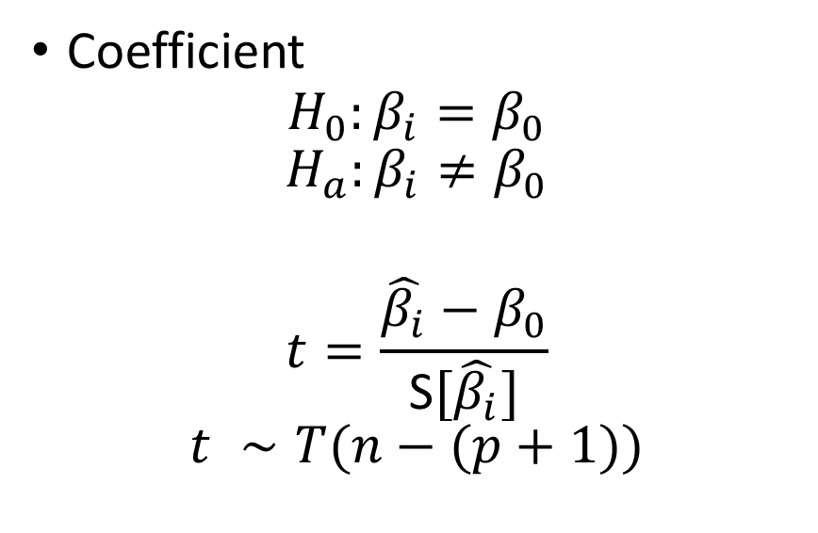
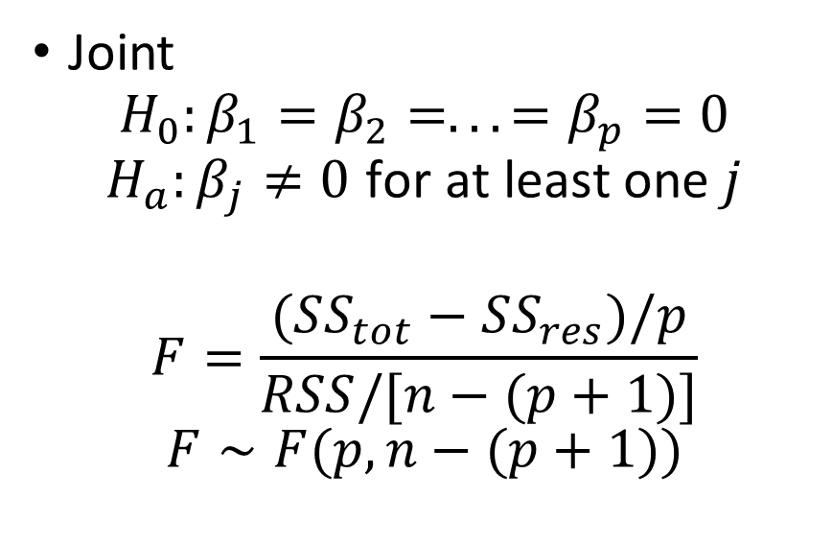
Hypothesis Testing
Coefficient
$$H_{0}:β_{i}=β_{0}$$
$$H_{a}:β_{i}≠β_{0}$$
$$t=\frac{\hat{β_{i}}−β_{0}}{\text{S}[\hat{β_{i}}]}$$
$$t ∼T(n−(p+1))$$
Joint
$$H_{0}:β_{1}=β_{2}=...=β_{p}=0$$
$$H_{a}:β_{j}≠0 \text{for} \text{at} \text{least} \text{one} j$$
$$F=\frac{(SS_{tot}−SS_{res})/p}{RSS/[n−(p+1)]}$$
$$F∼F(p,n−(p+1))$$
P-value 0.05

Slide 23


R²
$$SS_{tot}=\sum_{i=1}^{n}{(}y_{i}−\overline{y})^{2}$$
$$\text{V}[y]=\frac{1}{n}SS_{tot}$$
$$SS_{tot}=SS_{reg}+SS_{res}$$
$R^{2}=\frac{SS_{tot}−SS_{res}}{SS_{tot}}$
$R^{2}=\frac{SS_{reg}}{SS_{tot}}$
$$R^{2}=\frac{\frac{1}{n}SS_{reg}}{\frac{1}{n}SS_{tot}}$$

Slide 24
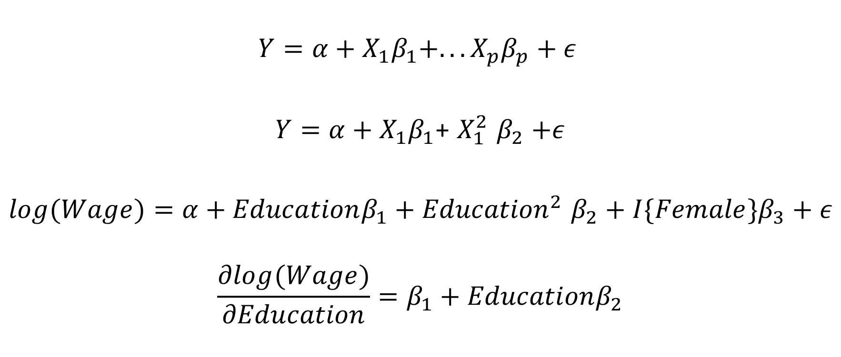
What is Meant by “Linear”
$$Y=α+X_{1}β_{1}+...X_{p}β_{p}+ε$$
$Y=α+X_{1}β_{1}$+ $X_{1}^{2}$ $β_{2}$ $+ε$
$log⁡(Wage)=α+Educationβ_{1}+{Education}_{ }^{2}$ $β_{2}$ $+$ $I\{Female\}β_{3}+ε$
$$\frac{∂log(Wage)}{∂Education}=β_{1}+Educationβ_{2}$$

Slide 25

Logarithm Variables
$$\log\left(Wage\right)=α+Educationβ_{1}+I\{Julian\}β_{2}+ε$$
$$\%Δ=\frac{New−Old}{Old}$$
$$f\left(x\right)=log\left(x\right)$$
$⟹$ $\frac{df(x)}{dx}=\frac{1}{x}$
$⟹$ $df \left(x\right)=\frac{dx}{x}=\%Δ$
If $β_{1}=−20$, then…

Slide 26

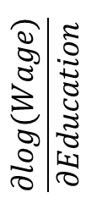
Involved Interpretation
$$\frac{∂log(Wage)}{∂Education}$$
$$Education$$

Slide 27
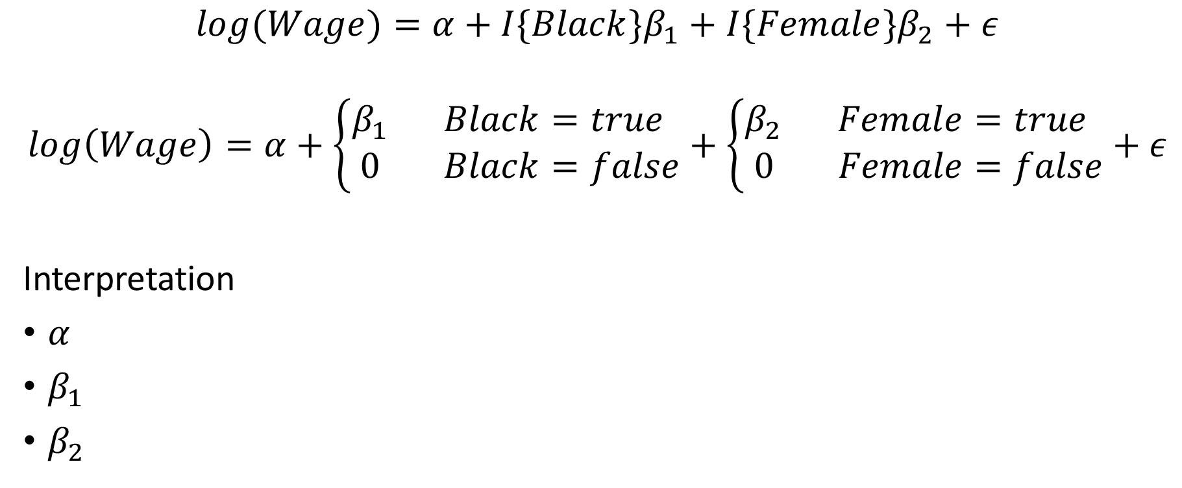
Dummy Variables
$log⁡(Wage)=α+I\{Black\}β_{1}+$ $I\{Female\}β_{2}+ε$
$$log\left(Wage\right)=α+\left\{\begin{matrix}β_{1} & Black=true \\ 0 & Black=false\end{matrix}\right.+\left\{\begin{matrix}β_{2} & Female=true \\ 0 & Female=false\end{matrix}\right.+ε$$
Interpretation
$α$
$β_{1}$
$β_{2}$

Slide 28

Elasticities
$${elasticity of demand}^{ }=\frac{\%ΔQ}{\%ΔP}<0$$
Cobb-Douglas Production Function
$$Y =e^{α+ε}L^{β_{1}}K^{β_{2}}$$
$$log(Y)=α+log(L)β_{1}+\text{log}(K)β_{2}+ε$$

Slide 29
To Do
Recommended
Read ISL Ch 3 (pg 59-102)
Highly Recommended
Do lab 3.6

